Slide 1






A MACHINE LEARNING PROJECT ON
Bhagvad Gita Translator

Slide 2

INTRODUCTION
Challenge: Sanskrit language limits access to Bhagavad Gita's wisdom.
Solution: Web-based Shloka translator using machine learning.
Benefits: User-friendly tool for wider audience to understand Bhagavad Gita.
Report Structure:
~Current translations & limitations
~Methodology (data, models, web app)
~Evaluation (performance & testing)
~Future work (improvements & features)

Slide 3
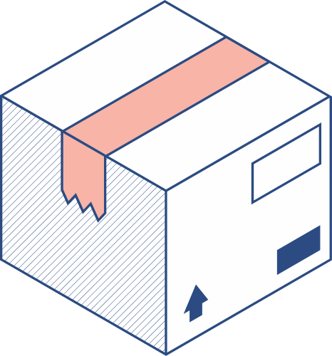
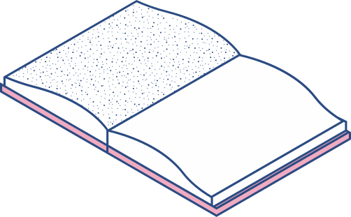

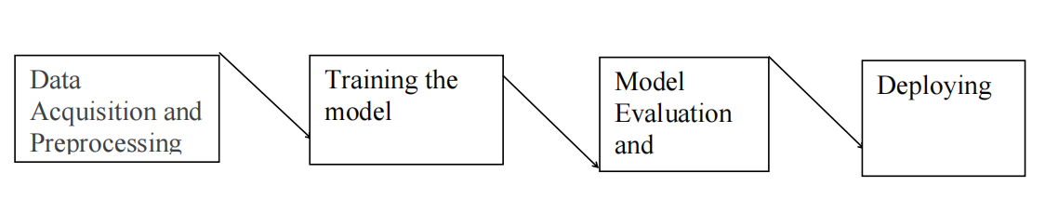
PROJECT WORK FLOW

Slide 4

Training The Model
This phase consists of 4 parts they are:-
1. Choosing a machine learning algorithm
2. Training
3. Evaluation

Slide 5

TRAINING
Cleaning: The data may contain inconsistencies, typos, or formatting errors. We implemented cleaning techniques to ensure data quality, such as removing irrelevant symbols, handling punctuation, and normalizing text. | Tokenization: We segmented the text into individual words or meaningful units (tokens) for machine learning algorithms to process. This might involve splitting sentences into words, handling compound words, and potentially applying stemming or lemmatization (reducing words to their root forms). | Vectorization: The preprocessed text needs to be converted into a numerical representation suitable for machine learning models. We could employ techniques like one-hot encoding, word embedding (representing words as vectors based on their context), or other suitable methods.

Slide 6
evaluate the performance of the model using the testing dataset
code searches through different machine learning algorithms
Sequene Model, Neural Machine Translation,Statistical Machine Translation
final model fits the data, generalizes effectively to unseen data.
best-performing model and its optimal configuration
Evaluation/
Cross-validation

Slide 7

Understanding
This project implements a supervised neural machine translation (NMT) model totranslate Sanskrit text to Hindi. The model utilizes a Seq2Seq architecture with an encoderdecoder structure. The encoder processes the Sanskrit input sentence, while the decodergenerates the corresponding Hindi translation. An attention mechanism is incorporated withinthe decoder to focus on relevant parts of the encoder output during the translation process.Additionally, Google Translate API is employed to translate the generated English outputfrom the NMT model to Hindi for a final Hindi translation. The model is trained on a parallelcorpus of Sanskrit and English sentences, and its performance is evaluated on a separate testset using BLEU score.

Slide 8
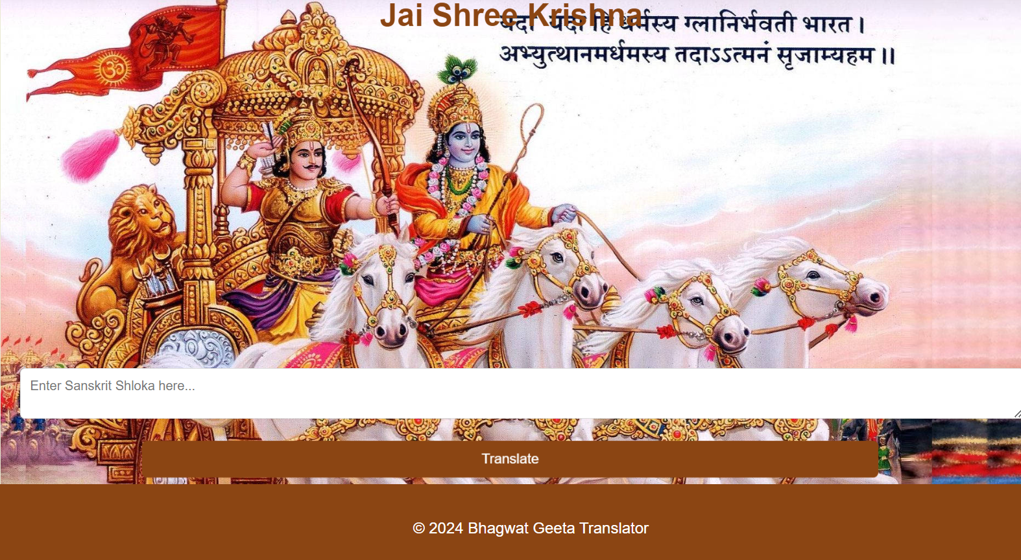
FRONTEND

Slide 9
sequence models are versatile, capable of functioning in complex use-cases like machine translation, where the length of the input sequence (source language) does not necessarily match the length of the output sequence (target language). These models also facilitate 'many-to-one' tasks like sentiment analysis, where the entire text sequence gets evaluated for output, and 'one-to-many' tasks like music generation, where a single input triggers a series of outputs.
Why Sequence Model?

Slide 10
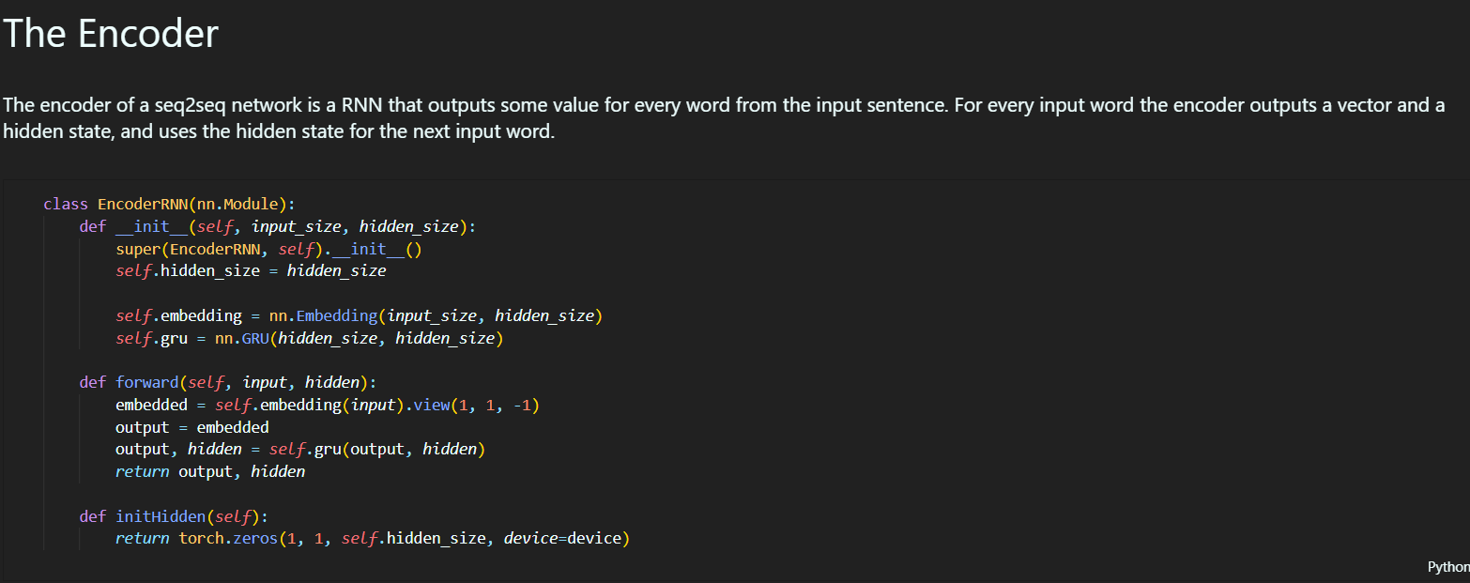

Slide 11
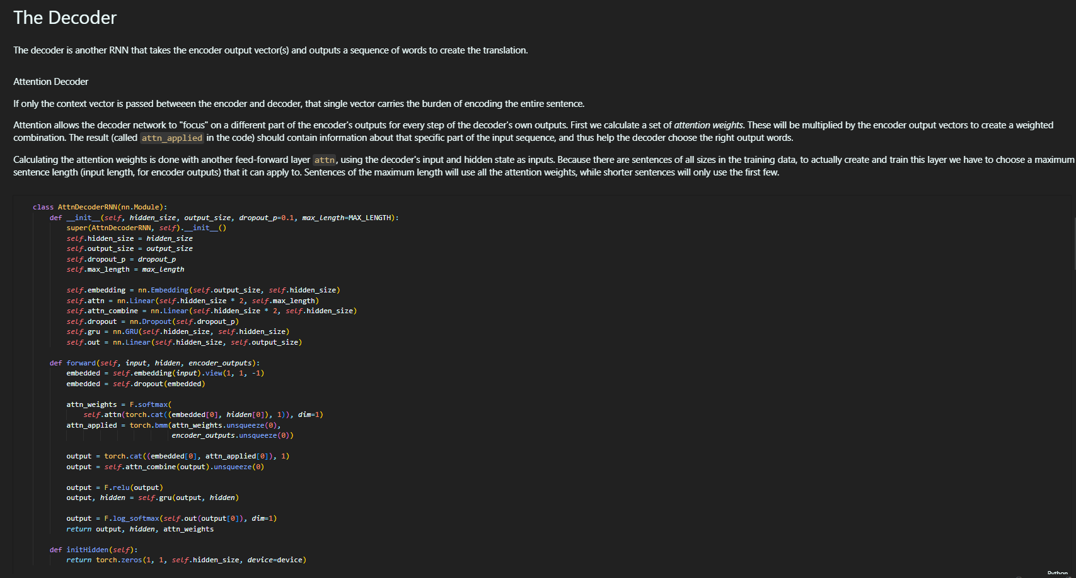

Slide 12



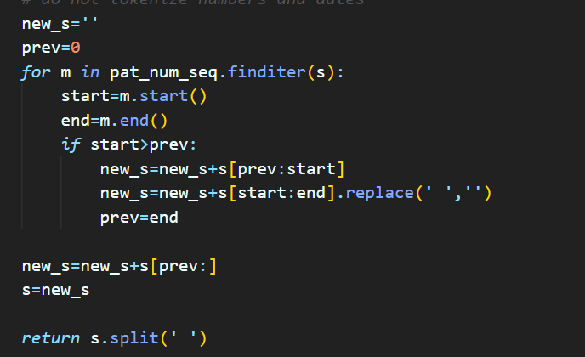

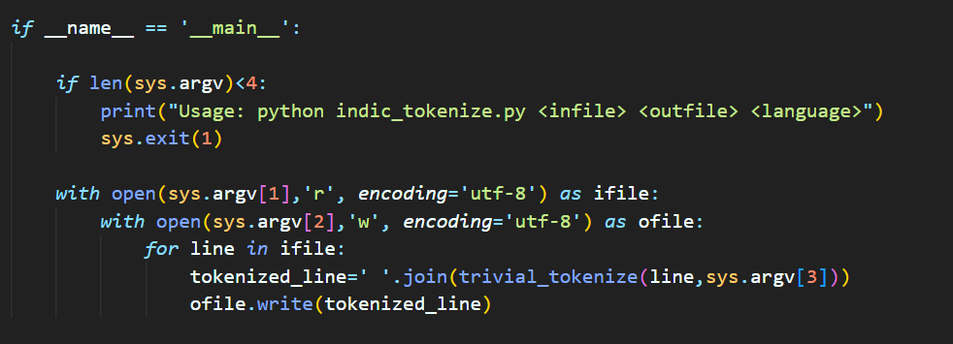
Tokenization

Slide 13
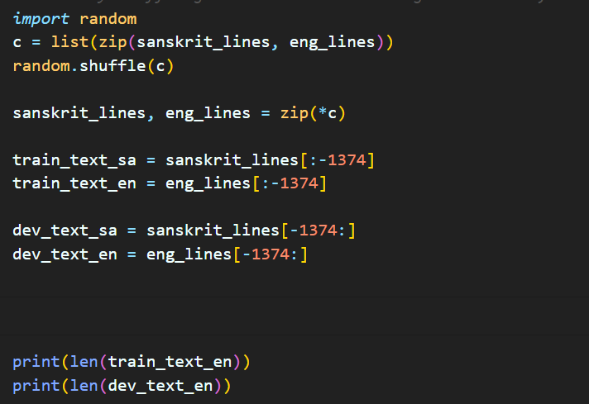
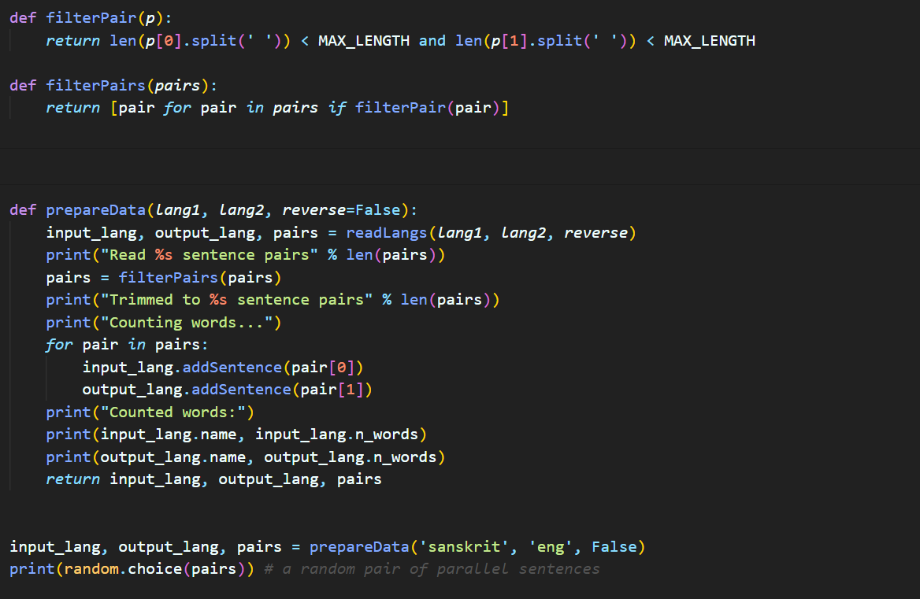
Training The Data
Filtering the data

Slide 14
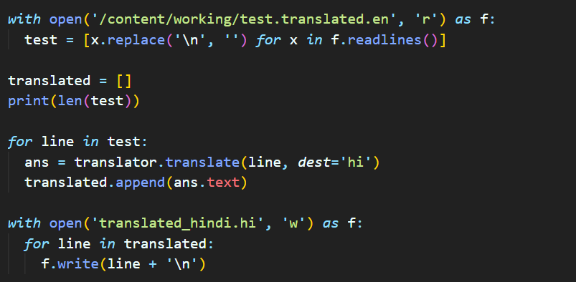
Translating Multiple files
Extracting the data into lists

Slide 15
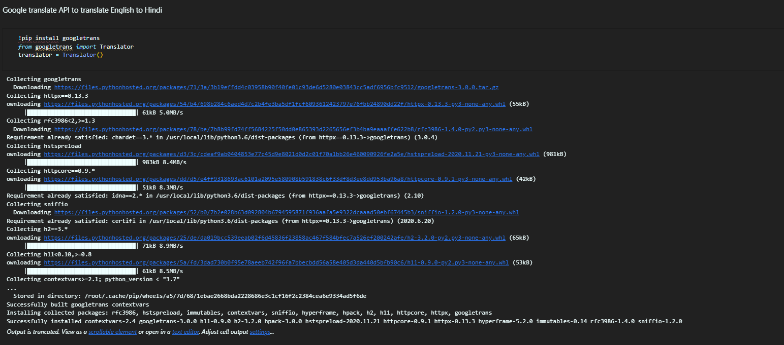
USING GOOGLE API FOR EFFECTIVE TRANSLATIONS

Slide 16
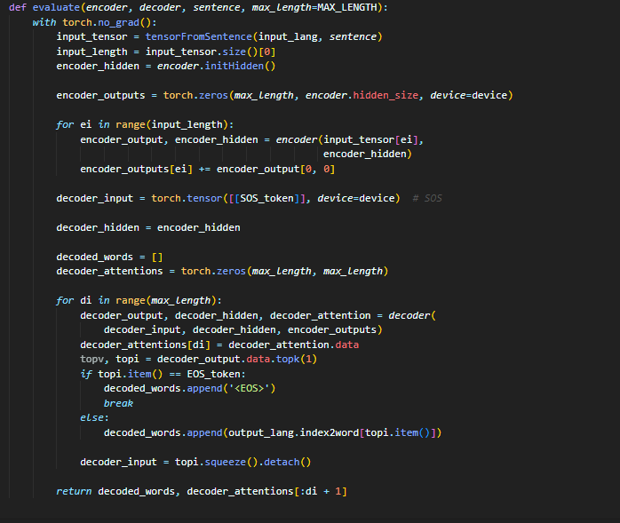

Bilingual Evaluation (BLEU)
METHOD | BLEU Score(%)
Supervised Statistical MT | 28.47
Supervised Neural MT | 31.43

Slide 17
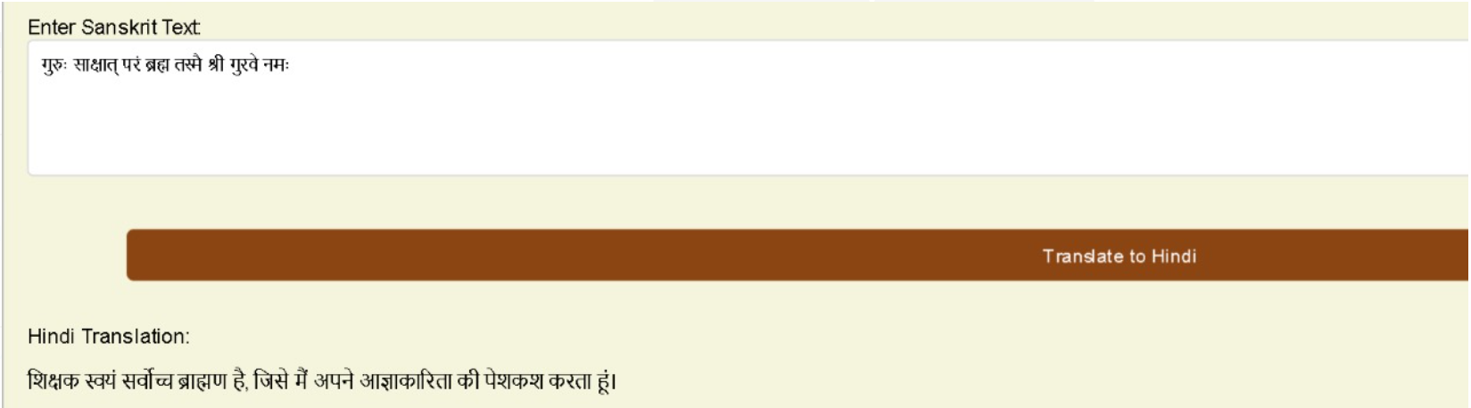
OUR RESULTS

Slide 18

Conclusion and Future Scope
This project successfully bridged the language gap for the Bhagavad Gita through a web-based machine learning translator, empowering a wider audience to access its wisdom. Future advancements include refining translation accuracy, incorporating additional languages, and enriching the user experience with features like audio playback and cultural context annotations, ultimately transforming this translator into a powerful tool for global understanding and appreciation of the scripture.

Slide 19




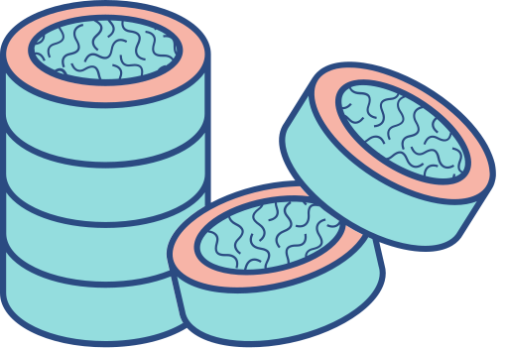


REFERENCES
1. vedabase.io
2. Bhagavadgita.io
3.https://www.gitasupersite.iitk.ac.in/srimad
4. Guillaume Lample, Myle Ott, Alexis Conneau, Ludovic Denoyer,and
Marc’Aurelio Ranzato. 2018b. Phrase-based & neural unsupervised machine translation. In Proceedings of the 2018 Conference on Empirical Methods in Natural Language Processing (EMNLP)
5. Ilya Sutskever, Oriol Vinyals, and Quoc V. Le. 2014. Sequence to sequence learning with neural networks.

Slide 20
OUR TEAM
LAKSHYA AGARWAL - 21051739
PRASOON KARN - 21051751
SHAUKARA SHRAVAN KUMAR - 21051758

Slide 21


THANK YOU

